Slide 1
Advertising and sales analysis

Slide 2
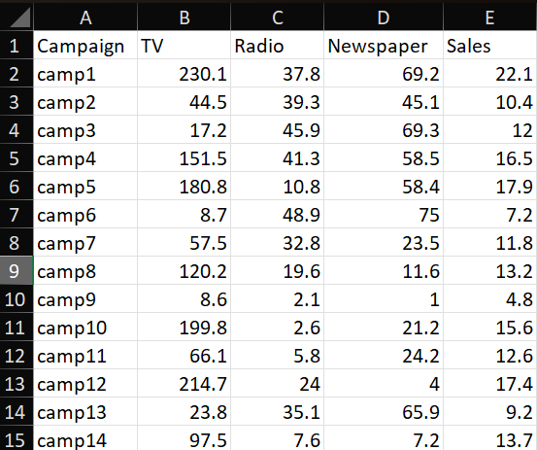
Introduction
Let’s understand about the advertising expenditures of a company on various platforms (TV, Radio, newspapers) and the corresponding sales of a product
Here's an explanation of the dataset:
TV: This column represents the amount of money spent on advertising the product on television.
2. Radio: This column indicates the advertising expenditure on radio.
3. Newspaper: This column shows the advertising cost spent on newspaper advertising.
4. Sales: This column represents the number of units sold corresponding to the advertising expenditures on TV, Radio, and newspapers.

Slide 3
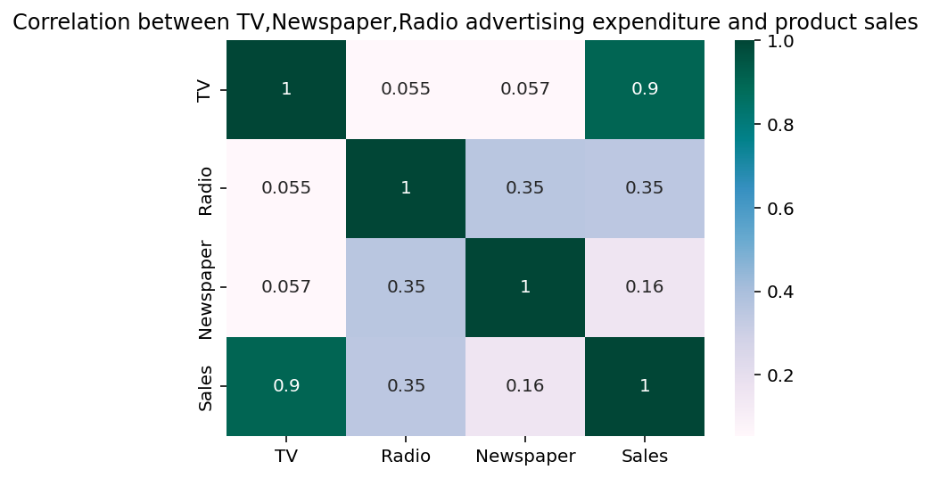
RELATIONSHIPS BETWEEN EACH CATEGORIES
TV & Sales (0.90): Very strong positive correlation, suggesting TV advertising has the biggest impact on product sales.
Radio & Sales (0.30): Moderate positive correlation, indicating Radio contributes to sales but less than TV.
Newspaper & Sales (0.16): Weak positive correlation, implying Newspaper advertising is the least effective among the three.
TV & Radio / TV & Newspaper (~0.05): Almost no direct correlation between TV and the other two channels.
Radio & Newspaper (0.35): Moderate positive correlation, indicating these two channels sometimes move together in spending.

Slide 4
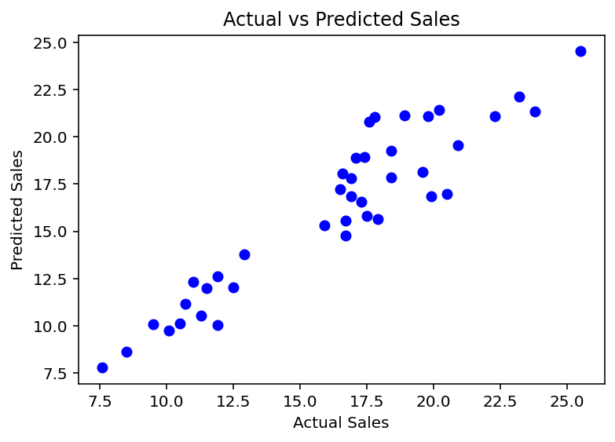
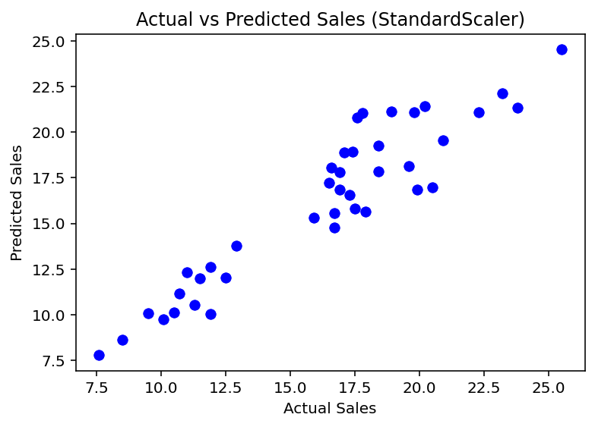
Linear Regression model
The model seems to be consistent on the basis of graphs even when data is standardize from this we can conclude that the data is continuous and has comparable scale.

Slide 5
CONCLUSION:
TV Dominates Sales Impact: The analysis consistently shows that TV advertising has the strongest relationship with sales, making it the most critical channel for driving revenue.
Data Characteristics: The dataset consists of continuous variables that are well-behaved and similarly scaled, as evidenced by the model's consistent performance with and without standardization.
Model Robustness: Linear regression effectively predicts sales using the three advertising channels. The robustness across scaling indicates that the data is neither heavily skewed nor imbalanced.
Strategic Implications: While radio and newspaper advertising do contribute to sales, their impact is much less pronounced. Focusing resources on TV advertising may yield better returns, though a balanced approach should be considered depending on overall marketing strategy.

Slide 6

Thank you
HITESH CHOUDHARY,
FINLATICS.

